Slide 1
Core Java – Part 3

Slide 2
What we will cover today?
Objects – Properties and Methods
Constructor , Getters and setters
Encapsulation
Access Specifier and Modifiers
Constructor and Method Overloading
this object
Static variables & methods
Varargs
Java Built-In classes

Slide 3
I want to create an Object. Now what to do?
Properties
Things that your object should know.
Methods
Things that your object can do.

Slide 4
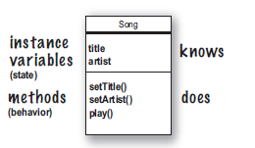
Few more examples of Objects ☺

Slide 5






Identify properties and methods…

Slide 6
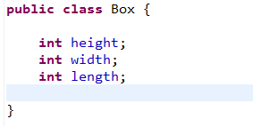
How to create class in java…

Slide 7
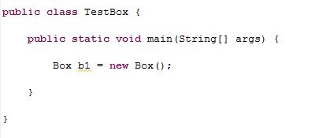
How the magic happens?

Slide 8
How Object is created?
Create an Object
new Box();
Declare a reference variable
Box b1;
Assign reference variable to the object
Box b1 = new Box(3,3,3);
Set values for Object
b1.height = 3;
b1.width = 3;
b1.length = 3;

Slide 9
Access specifier
An access specifier is a defining code element that can determine which elements of a program are allowed to access a specific variable or other piece of data.
Access Specifiers
public
private
protected
package

Slide 10
Methods
Method is a block of code which can be accessed whenever needed.
Methods returning values Need to specify return type before Method name. Must return some value.Ex: int addNumbers(int x, int y) { return x+y; }
Methods not returning values Need to specify return type as void. Ex: void incrementNumber(Integer x) { int y=x.intValue(); y++; //y is incremented }

Slide 11
Methods – Assignment (Simple)
Create a class named Eggs Create a method calculateEggs() in the class Pass no of eggs to this method and display the eggs in dozen
For eg if no of eggs are 50 method should display 4 dozen and 2 eggs
Create a class TestEggs to test the Eggs class
Your task is to write a program that simulates a vending machine. Users select a product and provide payment. If the payment is sufficient to cover the purchase price of the product, the product is dispensed and change is given. Otherwise, the payment is returned to the user. Create 2 arrays, 1 to store product names and other product price. Display the menu to the user and based on users choice display the details

Slide 12
Vending Machine Enums
Your task is to write a program that simulates a vending machine. Users select a product and provide payment. If the payment is sufficient to cover the purchase price of the product, the product is dispensed and change is given. Otherwise, the payment is returned to the user.
Create an Enum VendingItem as follows:
price should be a parameter to the enum constructor.
Item | Price
Lays | $1.50
Doritos | $1.50
Coke | $2.50
Ramblin_Reck_Toy | $180.75
Rubiks_Cube | $30.00
Rat_Cap | $15.00
FASET_Lanyard | $10.00
Cheetos | $1.25
Sprite | $2.50
Red_Bull | $4.75
Ramen | $3.15
Cold_Pizza | $0.99
Notes:
https://cs1331.gitlab.io/fall2018/hw3/hw3-vending-machine.html
https://coderanch.com/t/643124/engineering/implement-vending-application

Slide 13
Methods – Assignment (Simple) Solution
public class Vending {
private String products[]= {"COOkie","Coke","M&M","COffee"};
private int price[] = {10,15,5,12};
public void displayMenu()
{
System.out.println("Select an item");
for(int i=0;i<products.length;i++)
{
System.out.println((i+1) +" -> "+products[i]+"\t"+price[i]);
}
}
public void calculate(int product,double amount)
{ for(int i=0;i<products.length;i++){
if(products[i].equals(product)){
double p = price[i];
if(amount>=p){
System.out.println("Have your "+product);
System.out.println("Your change "+(amount - p));
}
else
System.out.println("INsufficient Amount");
}
}
}
}

Slide 14
Methods - Assignment
Define a class Employee having the following description:
Data members
int pan to store personal account number
String name to store name
double taxincome to store annual taxable income
Member functions :
void input ( ) : Store the pan number, name, taxable income
Double cal ( ) : Calculate tax of an employee and returns the calculated tax
void display ( ) : Output details of an employee
Write a program to compute the tax according to the given conditions and display the output as per given format:
Output:
Pan Number Name Tax-Income Tax
…………………. ………. …………………. ………………….
…………………. ….……. …………………. ………………….
Total annual taxable income | Tax Rate
Up to ₹ 1,00,000 | No tax
From ₹ 1,00,001 to ₹ 1,50,000 | 10% of the income exceeding ₹ 1,00,000
From ₹ 1,50,001 to ₹ 2,50,000 | ₹ 5,000 +20% of the income exceeding ₹1,50,000
Above ₹ 2,50,000 | ₹25000 + 30% of the income exceeding ₹2,50,000

Slide 15
Methods – Assignment Solution
public class Employee {
private int pan;
private String name;
private double taxincome;
public void input(int p, String n, double ti)
{
pan = p;
name = n;
taxincome = ti;
}
public void display()
{
System.out.println("Pan No "+pan);
System.out.println("Name "+name);
System.out.println("Tax Income "+taxincome);
System.out.println("Tax "+cal());
}
}
double cal()
{
if(taxincome >100000 && taxincome <=150000)
{
double inc = taxincome - 100000;
return 0.1 * inc;
}
else if(taxincome >150000 && taxincome <=250000) {
double inc = taxincome - 150000;
return 5000 + 0.2 * inc;
}
else if(taxincome > 250000)
{
double inc = taxincome - 100000;
return 25000 + 0.3 * inc;
}
return 0.0;
}

Slide 16
Java Source File Structure
There can be only one public class per source code file.
If there is a public class in a file, the name of the file must match the name of the public class.
For example, a class declared as public class Dog { } must be in a source code file named Dog.java.
If the class is part of a package, the package statement must be the first line in the source code file, before any import statements that may be present.
A file can have more than one non-public class.
Files with non~public classes can have a name that does not match any of the classes in the file

Slide 17
Constructor
Constructor is a special type of method that is used to initialize the object.
Constructor is invoked at the time of object creation. It constructs the values i.e. provides data for the object that is why it is known as constructor.
Rules for creating constructor
There are basically two rules defined for the constructor.
Constructor name must be same as its class name
Constructor must have no explicit return type

Slide 18
Constructor cont..
Types of constructors
There are two types of constructors:
default constructor (no-arg constructor)
parameterized constructor
Types of constructors
default constructors
parameterized constructors
IMPLICIT
EXPLICIT

Slide 19
Constructor Assignment - 1
Create a class called circle as below :
Two private instance variables: radius (of the type double) and color (of the type String), with default value of 1.0 and "red", respectively.
Two overloaded constructors - a default explicit constructor with no argument, and a constructor which takes a double argument for radius.
Two public methods: getRadius() and getArea(), which return the radius and area of this instance, respectively.
Write a test class called TestCircle (in another source file called TestCircle.java) which uses the Circle class and displays the radius and area of the circle.

Slide 20
Constructor Assignment - 2
Define a class Bill that calculates the telephone bill of a consumer with the following description:
Instance variables/data members:
int bno : bill number
String name : name of consumer
int call : no. of calls consumed in a month
double amt : bill amount to be paid by the person
Methods/ Members functions :
Bill(…) : parameterized constructor to accept billno,name and no. of calls
consumed.
calculate() : to calculate the monthly telephone bill for a consumer as per the
following condition
Fixed Monthly rental applicable to all consumers: ₹ 125
Display() : To display the details
Create a class TestBill and create Bill object in the main() method and invoke the above function to perform the desired task.
Units consumed | Rate
First 100 calls | ₹ 0.60/call
Next 100 calls | ₹ 0.80/call
Next 100 calls | ₹ 1.20/call
Above 300 calls | ₹ 1.50/call

Slide 21
Object Oriented Features - Encapsulation
It’s cruel world. Never trust any programmer!
Mark instance variable private.
Create getters and setter methods.
Validate data before setting it.
Mark these methods public.

Slide 22
toString()
To represent any object as a string
Returns the string representation of the object.
Print any object, java compiler internally invokes the toString() method on the object.
So overriding the toString() method, returns the desired output, it can be the state of an object etc. depends on your implementation.

Slide 23
this in java
Within an instance method or a constructor, this is a reference to the current object — the object whose method or constructor is being called.
You can refer to any member of the current object from within an instance method or a constructor by using this.
Using this with a Field The most common reason for using the this keyword is because a field is shadowed by a method or constructor parameter.
Using this with a Constructor From within a constructor, you can also use the this keyword to call another constructor in the same class. Doing so is called an explicit constructor invocation.
Notes:
https://docs.oracle.com/javase/tutorial/java/javaOO/thiskey.html

Slide 24
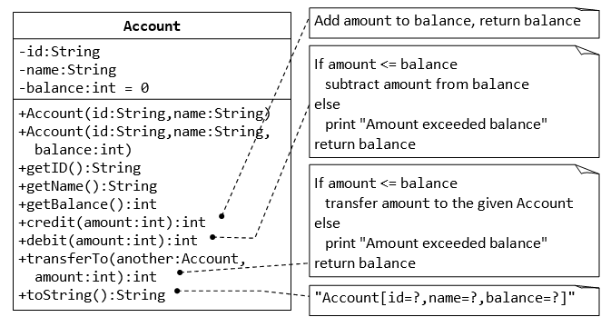
Assignment
Notes:
https://docs.oracle.com/javase/tutorial/java/javaOO/thiskey.html

Slide 25
public class Account {
private String id,name;
private int balance;
public Account(String id, String name) {
this.id = id;
this.name = name;}
public Account(String id, String name, int balance) { this.id = id;
this.name = name;
this.balance = balance;
}
public String getId() {return id;}
public String getName() {return name;}
public int getBalance() {return balance;}
public void credit(int amount)
{this.balance = this.balance + amount;}
public int debit(int amount) {
if(this.balance > amount)
{this.balance = this.balance - amount;}
return this.balance;}
public void transfer(Account another, int amount){
if(this.balance > amount) {
this.balance = this.balance – amount; another.credit(amount);
}else System.out.println("Amount cannot be transferred");}
@Override
public String toString() {
return "Account [id=" + id + ", name=" + name + ", balance=" + balance + "]"; }
}
public class TestAccount {
public static void main(String[] args) {
Account a1 = new Account("A001", "Shalini",500);
Account a2 = new Account("A002", "Sia",1500);
a1.transfer(a2, 300);
System.out.println(a1);
System.out.println(a2);
}
Notes:
https://docs.oracle.com/javase/tutorial/java/javaOO/thiskey.html

Slide 26
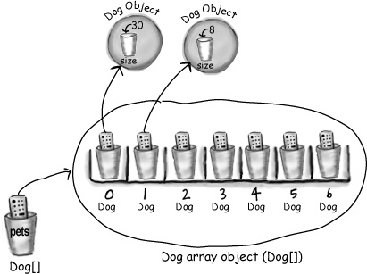
Arrays continued…
Array of Dog Objects

Slide 27
Has – A Relationship
Means an instance of one class “has a” reference to an instance of another class or another instance of same class.
It is also known as “composition” or “aggregation”.
There is no specific keyword to implement HAS-A relationship but mostly we are depended upon “new” keyword.
Composition : Without existence of container object, if there is no chance of existence of contained objects then container and contained objects are said to be strongly associated and this strong association is known as composition. Eg: A “university” has several “departments”. Without existence of “university” there is no chance for the “departments” to exist. Hence “university” and “departments” are strongly associated and this strong association is known as composition.
Aggregation Without existence of container object, if there is a chance of existence of contained objects then container and contained objects are said to be loosely associated and this strong association is known as aggregation. Eg: A “department” has several “professors”. Without existence of “departments” there is good chance for the “professors” to exist. Hence “professors” and “department” are loosely associated and this loose association is known as Aggregation.

Slide 28
Polymorphism in Java
There are two types of polymorphism in java:
Compile time polymorphism and runtime polymorphism.
We can perform polymorphism in java by method overloading and method overriding.
Runtime polymorphism or Dynamic Method Dispatch is a process in which a call to an overridden method is resolved at runtime rather than compile-time.

Slide 29
Method Overloading in Java
If a class has multiple methods having same name but different in parameters, it is known as Method Overloading. Advantage of method overloading
Method overloading increases the readability of the program.
There are three ways to overload the method in java
By changing number of arguments
By changing the data type
By changing sequence of arguments In java, Method Overloading is not possible by changing the return type or access specifier of the method only.

Slide 30
Can we overload java main method?
Yes, by method overloading. You can have any number of main methods in a class by method overloading.
But JVM calls main() method which receives string array as arguments only. Let's see the simple example:
class TestOverloading4
{
public static void main(String[] args){
System.out.println("main with String[]");}
public static void main(String args){
System.out.println("main with String");}
public static void main(){
System.out.println("main without args");}
}

Slide 31
Memory Management
The JVM divided the memory into following sections. 1. Heap - Objects (may also contain reference variables). 2. Stack - contains methods, local variables and reference variables. 3. Code - contains your bytecode. 4. Static - contains Static data/methods.
This division of memory is required for its effective management. Stack vs Heap

Slide 32
Access modifiers
We know access specifiers specify
the access of variable ,methods and classes and access modifiers modify the access of variables, methods and classes. In general, an access modifier works between the classes of the same application or within the classes of same package.
Access Modifiers
Final
Static
Transient
Volatile
synchronized

Slide 33
Static Keyword
The static keyword in java is used for memory management mainly. We can apply java static keyword with variables, methods, blocks and nested class. The static keyword belongs to the class than instance of the class.
Instance Variable
Attached to class & not to any specific object
Every object will share same copy of the variable
Methods
Used for creating utility methods (ex. Generating random no)
Output of method never depends upon any object
Methods behavior has no dependency on the state of an object
Syntax
As static members are attached to class and not to any object,
you call them using <ClassName>.<variableName>
and <ClassName>.<methodName>

Slide 34
Static Variable
If you declare any variable as static, it is known static variable.
The static variable can be used to refer the common property of all objects (that is not unique for each object) e.g. company name of employees, college name of students etc.
The static variable gets memory only once in class area at the time of class loading.
S1 and s2 are objects
a is a data member of the class
B is a static variable

Slide 35
Static Method
If you apply static keyword with any method, it is known as static method.
A static method belongs to the class rather than object of a class.
A static method can be invoked without the need for creating an instance of a class.
static method can access static data member and can change the value of it.
The static method can not use non static data member or call non-static method directly.

Slide 36
Java static block
Is used to initialize the static data member.
It is executed before main method at the time of class loading.
A static block helps to initialize the static data members, just like constructors help to initialize instance members class Test{ static { //Code goes here } }

Slide 37
So now can you guess the meaning of….
public static void main(String args[])
{
// Code block }

Slide 38
String
Strings are a sequence of characters.
In the Java programming language, strings are objects.
The Java platform provides the String class to create and manipulate strings.
String class is encapsulated under java.lang package. In java, every string that you create is actually an object of type String. One important thing to notice about string object is that string objects are immutable that means once a string object is created it cannot be altered.

Slide 39
Creating a String
1) Using a String literal
String str1 = "Hello";
2) Using another String object
String str2 = new String(str1);
3) Using new Keyword
String str3 = new String("Java");
4) Using + operator (Concatenation)
String str4 = str1 + str2;
or,
String str5 = "hello"+"Java";

Slide 40
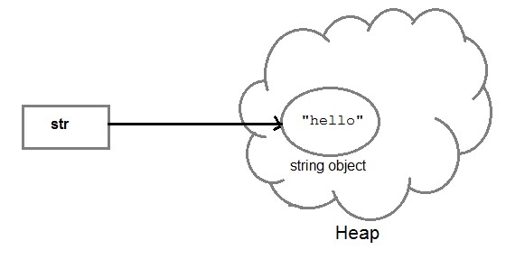
How are String Object Stored
When we create a new string object using string literal, that string literal is added to the string pool, if it is not present there already.

Slide 41
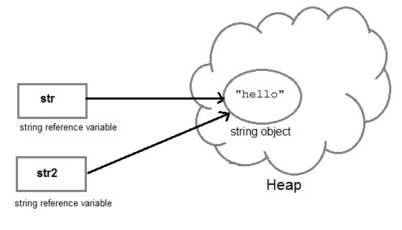
And, when we create another object with same string, then a reference of the string literal already present in string pool is returned.
String str2=str;

Slide 42
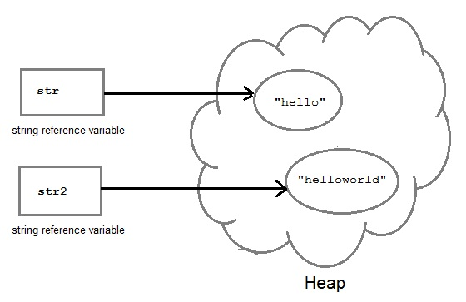
But if we change the new string, its reference gets modified.
str2=str2.concat("world");

Slide 43
Concatenating String
There are 2 methods to concatenate two or more string.
Using concat() method
Using + operator
1) Using concat() method
string s = "Hello";
string str = "Java";
string str2 = s.concat(str);
String str1 = "Hello".concat("Java"); //works with string literals too.
2) Using + operator
string str = "Rahul";
string str1 = "Dravid";
string str2 = str + str1;
string st = "Rahul"+"Dravid";

Slide 44
String Comparison
String comparison can be done in 3 ways.
Using equals() method
Using == operator
By CompareTo() method

Slide 45
equals Method
Using equals() method
equals() method compares two strings for equality. Its general syntax is,
boolean equals (Object str)
It compares the content of the strings. It will return true if string matches, else returns false.
String s = "Hell";
String s1 = "Hello";
String s2 = "Hello";
s1.equals(s2); //true
s.equals(s1) ; //false

Slide 46
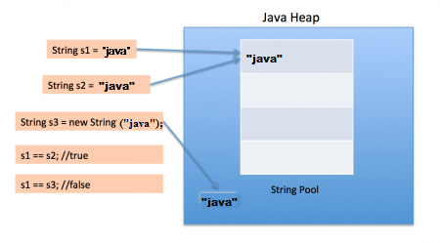
Using == operator
== operator compares two object references to check whether they refer to same instance. This also, will return true on successful match.
String s1 = "Java";
String s2 = "Java";
String s3 = new string ("Java");
test(s1 == s2) //true
test(s1 == s3) //false

Slide 47
By compareTo() method
compareTo() method compares values and returns an int which tells if the string compared is less than, equal to or greater than the other string. It compares the String based on natural ordering i.e alphabetically. Its general syntax is, int compareTo(String str) String s1 = "Abhi"; String s2 = "Viraaj"; String s3 = "Abhi"; s1.compareTo(S2); //return -1 because s1 < s2 s1.compareTo(S3); //return 0 because s1 == s3 s2.compareTo(s1); //return 1 because s2 > s1

Slide 48
StringBuffer class
StringBuffer class is used to create a mutable string object i.e its state can be changed after it is created.
It represents growable and writable character sequence.
As we know that String objects are immutable, so if we do a lot of changes with String objects, we will end up with a lot of memory leak.
So StringBuffer class is used when we have to make lot of modifications to our string. It is also thread safe i.e multiple threads cannot access it simultaneously.
StringBuffer defines 4 constructors. They are,
StringBuffer ( )
StringBuffer ( int size )
StringBuffer ( String str )
StringBuffer ( charSequence [ ]ch )
StringBuffer() creates an empty string buffer and reserves room for 16 characters.
stringBuffer(int size) creates an empty string and takes an integer argument to set capacity of the buffer.

Slide 49
Try this…………….
class Test {
public static void main(String args[])
{
String str = "study";
str.concat("tonight");
System.out.println(str);
StringBuffer strB = new StringBuffer("study");
strB.append("tonight");
System.out.println(strB);
}

Slide 50
StringBuilder class
StringBuilder is identical to StringBuffer except for one important difference that it is not synchronized, which means it is not thread safe. Its because StringBuilder methods are not synchronised.
StringBuilder Constructors
StringBuilder ( ), creates an empty StringBuilder and reserves room for 16 characters.
StringBuilder ( int size ), create an empty string and takes an integer argument to set capacity of the buffer.
StringBuilder ( String str ), create a StringBuilder object and initialize it with string str.

Slide 51
Difference between StringBuffer and StringBuilder class
StringBuffer class | StringBuilder class
StringBuffer is synchronized. | StringBuilder is not synchronized.
Because of synchronisation, StringBuffer operation is slower than StringBuilder. | StringBuilder operates faster.

Slide 52
Try this…
class Test {
public static void main(String args[])
{
StringBuilder str = new StringBuilder("study");
str.append( "tonight" );
System.out.println(str);
str.replace( 6, 13, "today");
System.out.println(str);
str.reverse();
System.out.println(str);
str.replace( 6, 13, "today");
}
}

Slide 53
Assignment
Q1. Write the logic behind find and replace using String functions.
Q2. Write the logic to change a case of a String.
Q3 Write the logic to check the length of the String and reverse the String using StringBuffer.
Q4.Using StringBuilder class write a logic to delete a part of a String
Q5. String path =“file:D:/java/strings/hello.java”. Get the filename from the path

Slide 54
Assignment - The Discount System
You are asked to write a discount system for a beauty saloon, which provides services and sells beauty products.
It offers 3 types of memberships: Premium, Gold and Silver. Premium, gold and silver members receive a discount of 20%, 15%, and 10%, respectively, for all services provided.
Customers without membership receive no discount. All members receives a flat 10% discount on products purchased (this might change in future).
Your system shall consist of three classes: Customer, Discount and Visit, as shown in the class diagram.
It shall compute the total bill if a customer purchases $x of products and $y of services, for a visit. Also write a test program to exercise all the classes.
Notes:
https://docs.oracle.com/javase/tutorial/java/javaOO/thiskey.html

Slide 55
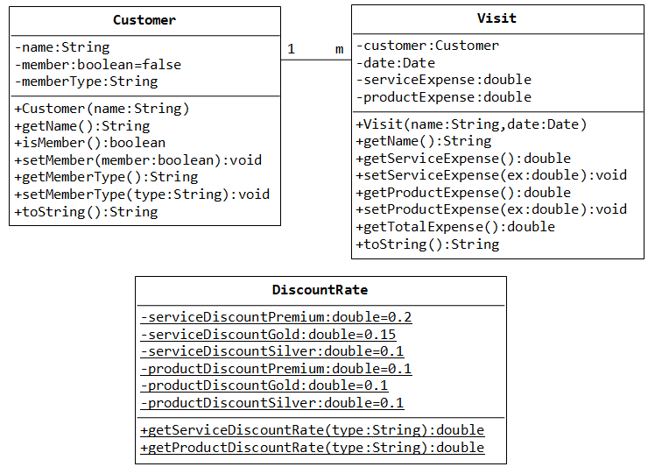
Assignment - The Discount System Contd..
Notes:
https://docs.oracle.com/javase/tutorial/java/javaOO/thiskey.html

Slide 56
Varargs
The varrags allows the method to accept zero or multiple arguments.
Before varargs either we use overloaded method or take an array as the method parameter
If we don't know how many argument we will have to pass in the method, varargs is the better approach.
Syntax of varargs:
The varargs uses ellipsis i.e. three dots after the data type. Syntax is as follows:
return_type method_name(data_type... variableName){}

Slide 57
Math
This class provide different static methods to perform mathematical operations.
Data Members: – public static final double PI; <Math.PI> – public static final double E; <Math.E>
Methods: – double abs(doublea) – double max(doublea,doubleb) – double min(doublea,doubleb) – double sin(doublea) – double cos(doublea) – double tan(doublea) – double sqrt(doublea) – double random() – double log(doublea) – double asin(doublea) – double exp(doublea,doubleb)

Slide 58
Mini Project – Invoice generation system
The task of our sample program is to print out an invoice.
An invoice describes the charges for a set of products in certain quantities. (We omit complexities such as dates, taxes, and invoice and customer numbers.) The program simply prints the billing address, all line items, and the amount due. Each line item contains the description and unit price of a product, the quantity ordered, and the total price.
INVOICE
Sam's Small Appliances
100 Main Street Anytown,
CA 98765
Description Price Qty Total
Toaster 29.95 3 89.85
Hair dryer 24.95 1 24.95
Car vacuum 19.99 2 39.98
AMOUNT DUE: $154.78
Notes:
https://docs.oracle.com/javase/tutorial/java/javaOO/thiskey.html

Slide 59
Indentify classes
Classes correspond to nouns in the requirements specification.
Invoice
Address
LineItem
Product
Description
Quantity
Total Amount due
Price
Product
- description : String - price : double
+ Product(description : String ,price : double) +//getters and setters
LineItem
- quantity : int - product : Product
+ LineItem(Product, qty : int) + getTotalPrice() : double + format() : String
Address
- name:string - street:string - city:string - state:string - zip:string
+ Address (name , street, city, state, zip) + format() : String
Invoice
- Billingaddress : Address - item : LineItem[ ]
+ add(Product, qty : int ) : void + format() : String + getAmountDue() : double
Notes:
https://docs.oracle.com/javase/tutorial/java/javaOO/thiskey.html

Slide 60

Any Question ?

Slide 61

Thank you !

